Slide 1


Sprint 2 Project Report

Slide 2

User Stories
As a Project Manager I need to have a database to store all the uploaded videos.
As a User I need to be able to sign in so I can upload videos for my friends to watch.
As a Project Owner I need a catchy name and logo for this project.

Slide 3
Sprint Goals
Database Integration
Project Name and Logo
Create Sign In Wireframe and build it
Apply Team colors to application

Slide 4
Issues We’ve Encountered and How We Fixed it
Switched from bootstrap 4 back to 3 because bootstrap 4 had features we needed but had to pay for.
Obtaining more video clips and the permission to use them.
FTP issues
Sickness/Spring Break

Slide 5

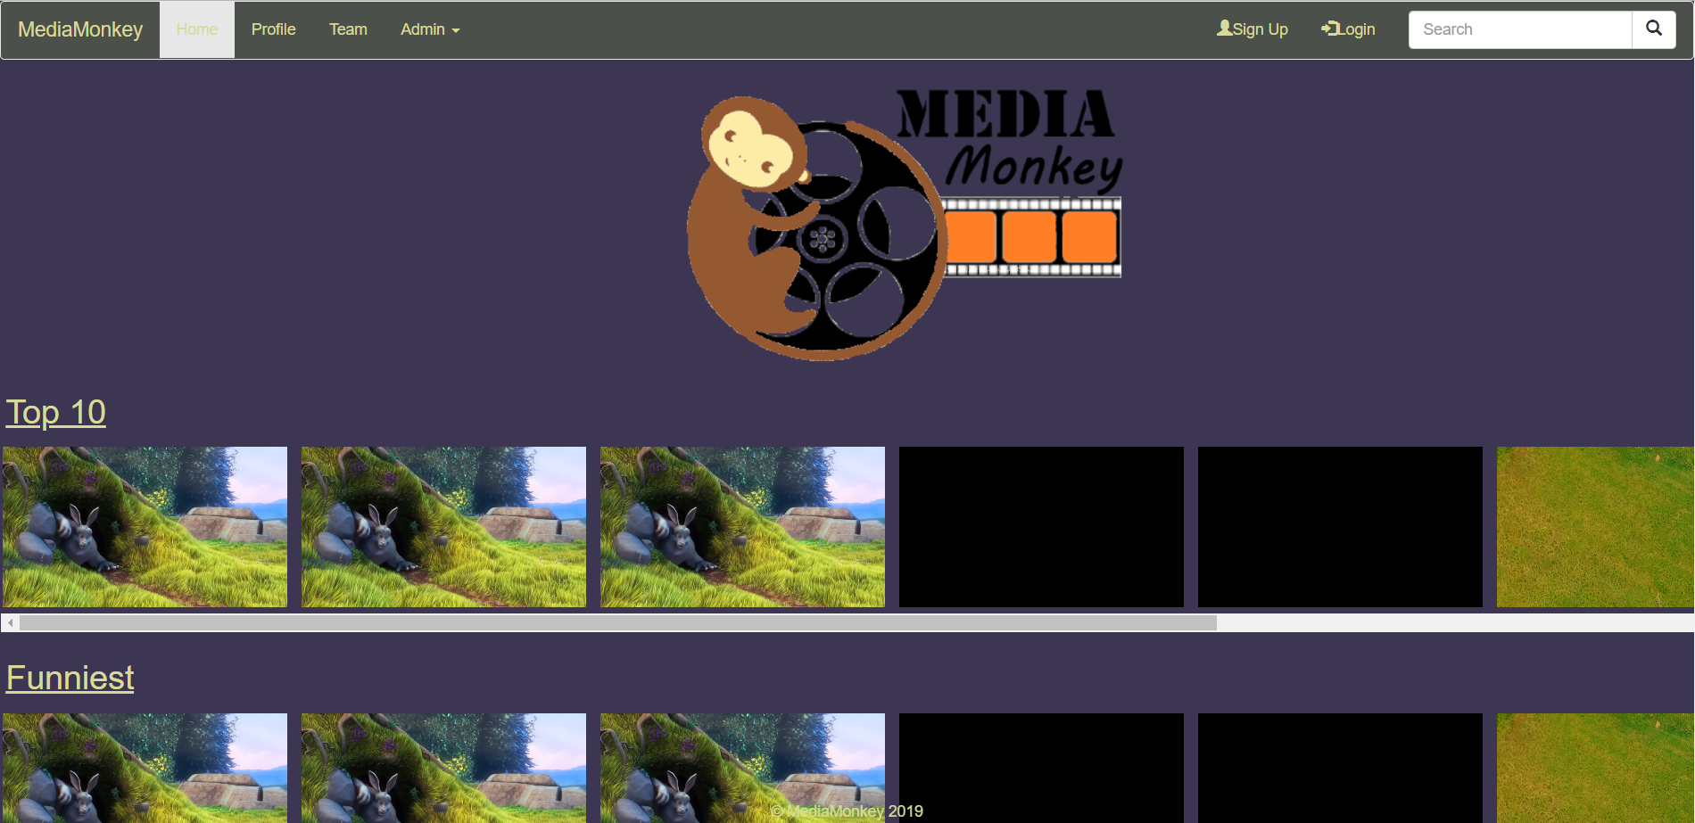
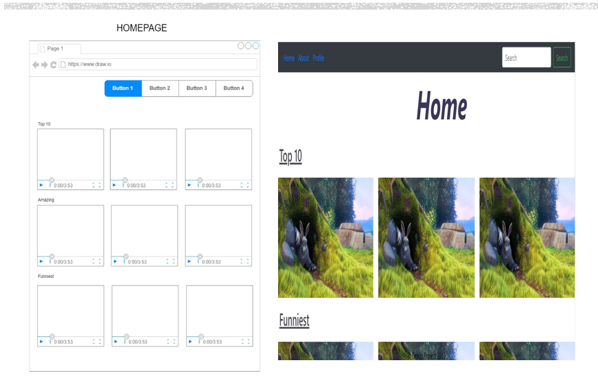
Sprint 1 vs Sprint 2

Slide 6

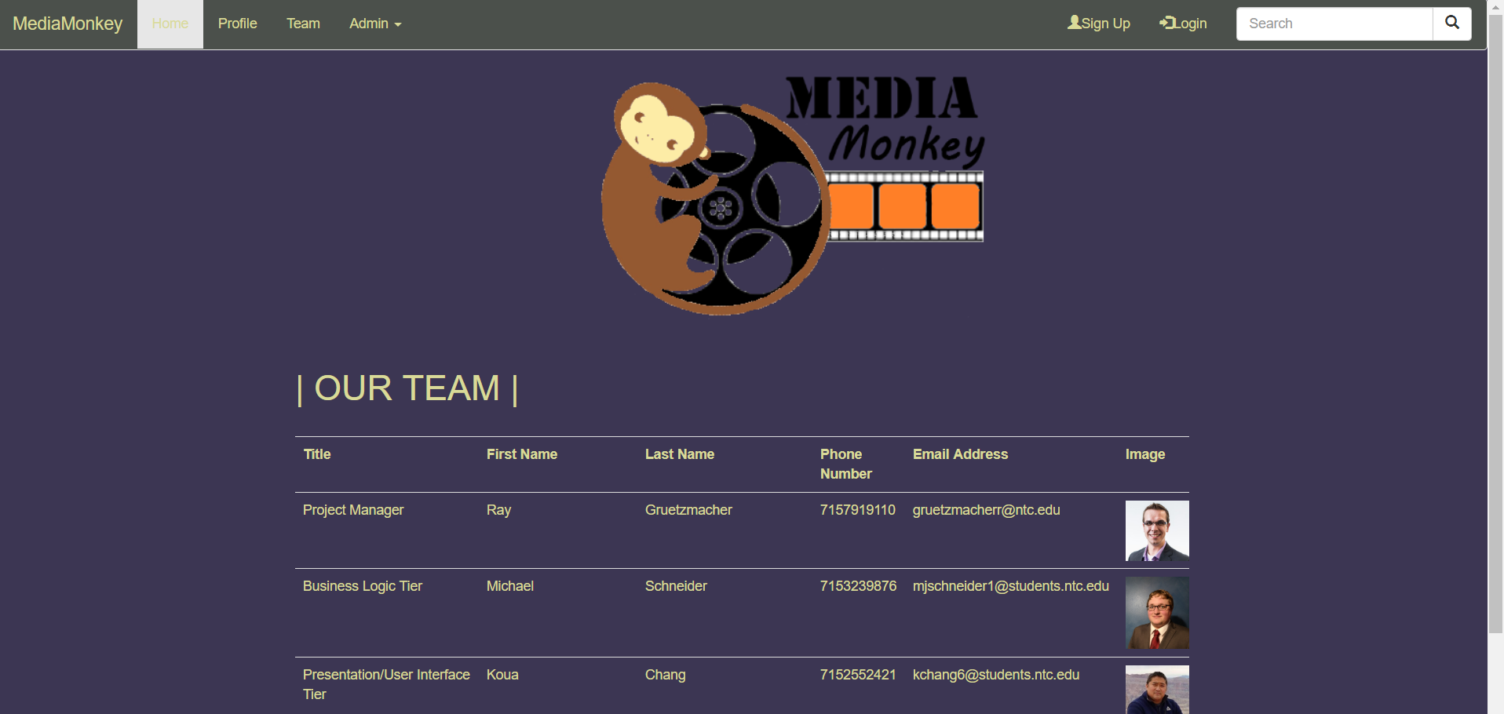
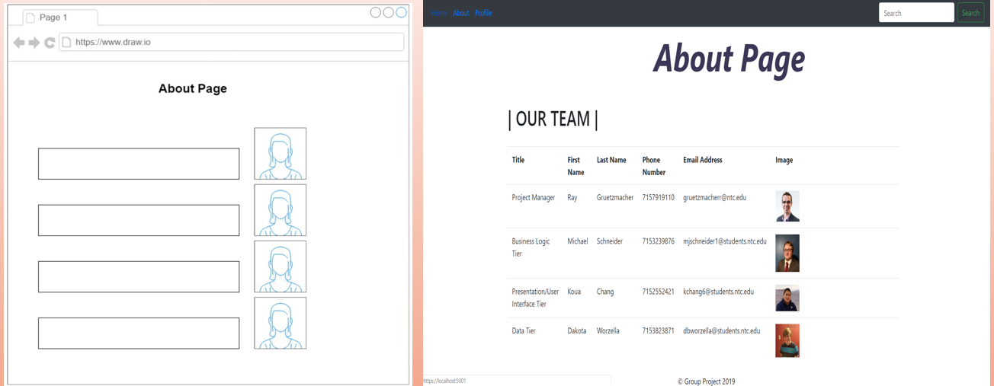
Sprint 1 vs Sprint 2

Slide 7
User Story For Sprint 3
As a User I need to be able to create a profile so that I can upload videos for my friends to see.
AC: User can sign in/ login and upload videos.

Slide 8

Demo Time!

